Slide 1
FAST FIVE – Thursday August 2nd
Welcome to AP European History with Ms. Tully!
Please sit wherever you like – we’ll get seating charts tomorrow.
Pick up a FAST FIVE worksheet from the front table.
Respond to the following FIVE questions in the first box on the worksheet.
What was the best park of your summer break?
Name one thing you are looking forward to for sophomore year
Name one things you are worried about for sophomore year
Are you involved in any extracurricular activities on or off campus?
What makes you happy?
FAST FIVE Facts:
FAST FIVE can be expected for every class day. Pick up a new worksheet at the start of every week.
You do not need to write the FAST FIVE prompt, just the response.
Complete sentences are not necessary.
FAST FIVEs will be submitted at the end of each week for a grade. If you are absent you are still expected to complete the FAST FIVE by referring to the prompts that will always be available the on class website.

Slide 2
Handouts!
Syllabus/Course Contract
Parent Letter
Portfolio Info
Homework Late Passes
My AP Euro Contact Sheet

Slide 3
Personal Essay – Due thurs. 8/9
Where are you from, have lived, and traveled?
Family – parents, their occupations, siblings, pets, etc..
Extra-curriculars, hobbies, sports, work
Strengths, weaknesses as a students, areas of concern
What one event, person passion, etc.. Has influenced you the most?
What are your interests/passions?
What do you like? What don’t you like?
Who are your friends?
What do you think of UHS?
What are simple things you enjoy doing in life?
Summer highlights? Lowlights?
Things you are looking forward to?
Best place you’ve ever been?
If you could go anywhere in the world, where would it be?
If you could be anything in the world, what would you be?
Goals you have for this school year?
Goals you have for life?

Slide 4
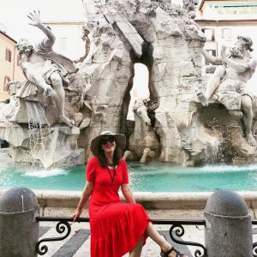
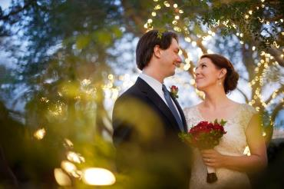
Who is ms. Tully?
Tucson, AZ
BFA from UofA, University of Washington
Pursuing Masters in History through University of
Edinburgh (in Scotland)
At UHS for eight years
Sponsor for Travel Club and World Traveler
Husband and 2 dogs (Trixie and Bowie)
Sci-Fi and History Nerd

Slide 5
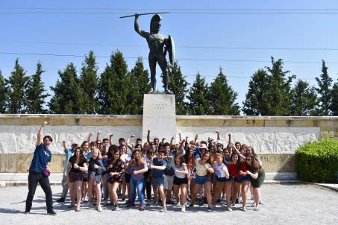
Travel club (www.uhstravelclub.com)
Domestic & International Travel Opportunities for UHS students since 2013
Tax Credit & Donation Eligible!
Upcoming Trips:
2019: France, Germany, and the Alps (Summer - 11 days)
2019: NYC & Washington DC (Spring Break) – Art History Students Only!
2020: Japan (Summer - 11 days)
Recruitment Meeting: Thursday, Aug. 23rd 6:00 p.m. in RUHS Auditorium
Learn about the history of the program and relationship with EF Tours
Information about itinerary, curriculum connections, cost and fundraising
Bring your parents and friends!
Questions?
www.uhstravelclub.com
uhstravelclub@gmail.com

Slide 6
Wrap-Up
What are you looking forward to learning about in AP European History this year?

